Slide 1
Failure Data
3/18/15
Cameron Ferguson

Slide 2
Background
About a month ago, Julie and Joe asked Travis to provide them with more Failure Reason information.
He did this manually for awhile, but then realized I was doing something similar for my R classes. So he asked me if I would try automating the process.
I ran with it and we have ended up with an easy to use, quick, and efficient R script which does what Travis was doing and more.

Slide 3
Quick Comparison
R Script’s
Very Old
Travis’s

Slide 4
Script Overview
Takes a single FileMaker export, performs some data manipulation and analysis in R, and provides information on Failures, as Excel Files.
Failure Reason
Breakdown
Mod Failure
Rate
FileMaker
Search
Export
Run Script
Seq ID Failure
Rate
Data Size | Export Time | Script Time | Total time | # of files (output)
1 Year | ~8 min | 30 Sec | 8’30’’ | 4
1 Month | ~30 sec | 5 sec | 35’’ | 4
1 Week | 5 sec | 30 sec | 35’’ | 1
1 Week | 5 sec | 2 sec | 7’ | 4
1 Day | 5 sec | 30 sec | 35’’ | 1
Seq Name Failure
Rate
Sequence Failure
Rate
Notes:
Can be done on any data range you can search for, as long as you can export the SAME categories in the Same Order.
Is relatively quick and efficient
Is easily modified and manipulated.
Some of the analysis break down when done on SHORT time frames, mostly due to low yield remakes.

Slide 5
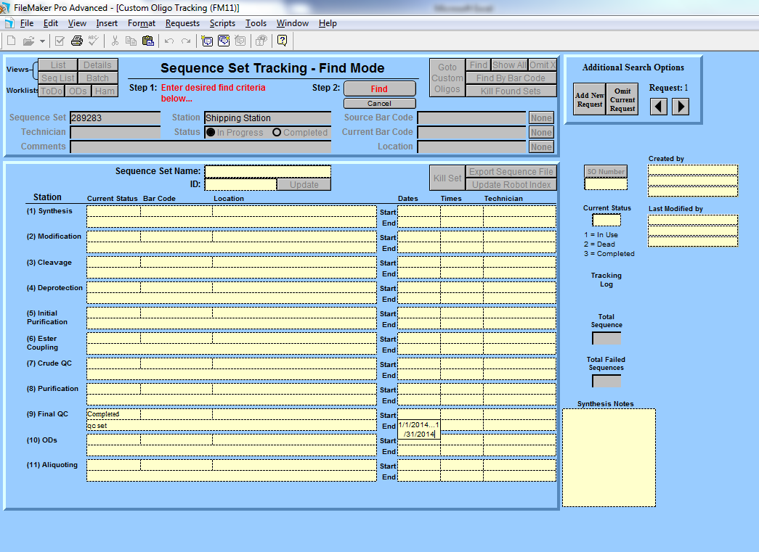
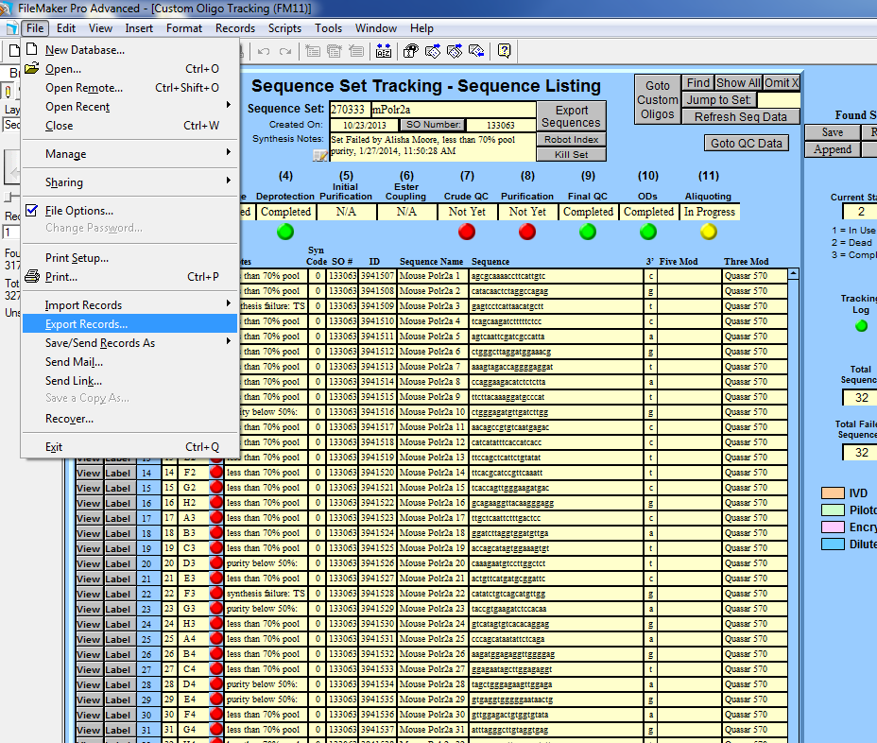
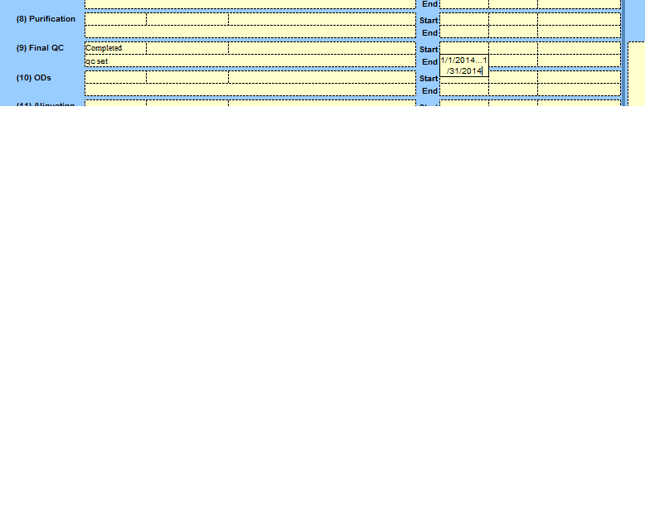
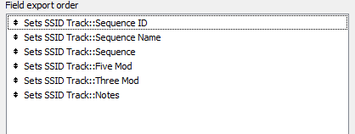
Filemaker Search/Export
Notes:
YOU CAN SEARCH ANYTHING.

Slide 6
Running the Script
Requirements
Steps
R
FailureDataProject folder
Raw FileMaker export file
Export data from FileMaker, and save in FailureDataProject Folder
Open R console
Set Working Directory in R to FailureDataProject folder
Can use File>Change dir…
Or setwd(PATH)
Type: source("failuredata.R")
Respond to Prompts
Wait for script to say: Finished!

Slide 7
FileMaker
Script Flow
Raw Data
# of Seq: 345780
Removed Sequences
Blank notes
293137
Non-Failure Filter
see
Extra Material
Archive material
Collection
Stellaris o
Pass
Wobble o
Wobbles o
Recheck
Relot
Re-lot
comb
Non-Failure
Notes
6440
# of Seq: 52643
Important Notes Data
# of seq: 46203
Error Percentage: 0.025% or 0.000253
Number of Failed sequences accidentally removed compared to total sequences (tested and averaged between two months)
Error Percentage2: 0.20%
Number of Failed sequences accidentally removed compared to total of sequences with notes (tested and averaged between two months)
Notes:
STRESS: Non-Failure filter is V Difficult w/o uniform notes

Slide 8
FileMaker
Script Flow
Failure Aggregation
Raw Data
# of Seq: 345780
ms o -> Ms Okay
ms n -> Ms Not Okay
assig -> Reassign
base -> Base-swap
wrong m -> Wrong Mass
flush -> Flushed
3 stel-> Stellaris Failure
every sample -> Stellaris Failure
all samples failed -> Stellaris Failure
stellaris f -> Stellaris Failure
more then three -> Stellaris Failure
more than 3 -> Stellaris Failure
extra tet -> Extra TET
tet -> Poor Tet Coupling
biotin -> Poor Biotin Coupling
extra fam -> Extra FAM
fam -> Poor FAM coupling
contamin -> Contamination
purity -> Poor Purity
n- -> N- Failure
syn -> Synthesis failure
colum -> Column Issue
flp-> No FLP no dn -> No FLP
dmt -> DMT left on
depur -> Depurination
mmt -> MMT left on
phosp -> Poor Phosphate coupling
poor j -> Poor Joe coupling
incom -> Incomplete Deprotection
benz -> Incomplete Deprotection
cyano -> Incomplete Deprotection
deprot -> Incomplete Deprotection
dye -> Dye failure
scram -> Plate Scrambled
yield -> Low Yield
yeild -> Low Yield
no dn -> Low Yield
-x or + x (x is 1:9) -> Impurity Present
Blank notes
293137
Non-Failure
Notes
6440
# of Seq: 52643
Important Notes Data
# of seq: 46203
Error Percentage: 0.028%
Notes changed incorrectly accidentally compared to total sequences (tested and averaged between two months)
Error Percentage 2: 0.3%
Notes changed incorrectly compared to Important Notes Data (tested and averaged between two months)
Preliminary Failed Seq Data
# of seq: 46203
Failure Aggregation
Notes:
Order: MS okay first, low yield later. Numbers LAST.
varied notes: Stellaris failures
Spelling: Yield Notes

Slide 9
FileMaker
Script Flow
Always one Excel File
-Summary
-Reason List
-Mod Analysis
Raw Data
# of Seq: 345780
Removed Sequences
Blank notes
293137
Non-Failure
Notes
6440
Separate Excel Files
# of Seq: 52643
Failed Seq Data
# of seq: 34820
Analysis
Sequence ID Analysis
Important Notes Data
# of seq: 46203
MS
Okay
8110
Sequence Name
Analysis
Reassign notes
3273
Preliminary Failed Seq Data
# of seq: 46203
Sequence
Analysis
Failure Aggregation

Slide 10
The Final Product
Summary,
Failure Reasons, Mod Failure Rates
Sequence ID Failure Rates
Sequence Name Failure Rates
Sequence Failure Rates
Notes:
Multi-well failures!

Slide 11
Future Aims/Needs
Need: Uniform Failure Names
Will make script easier, and data better
Need input from all departments that write notes
Cost analysis
Want: Suggestions, Ideas, categories, etc
Data Size | Export Time | Script Time | Total time | # of files (output)
1 Year | ~8 min | 30 Sec | 8’30’’ | 4
1 Month | ~30 sec | 5 sec | 35’’ | 4
1 Week | 5 sec | 30 sec | 35’’ | 1
1 Day | 5 sec | 30 sec | 35’’ | 1

